Slide 1


Corridor as a Service future of logistics
Blockchain
AI
MyData

Slide 2


Slide 3
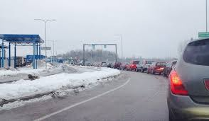
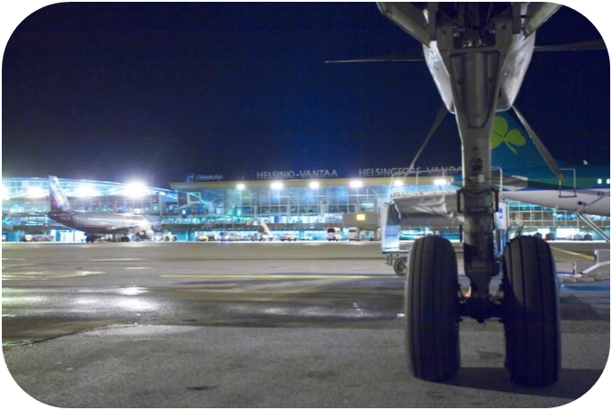

Vision exists in long term and in short term
Data Ecosystems – Real time Analytics – Data Sharing
DTL
Digital transaction
Digital transaction
Data privacy
Artificial
Intelligence

Slide 4






Tutkimus
Kokeilut
ANALYTICS
Liiketoiminta

Slide 5
DIGITAL TWIN

Slide 6
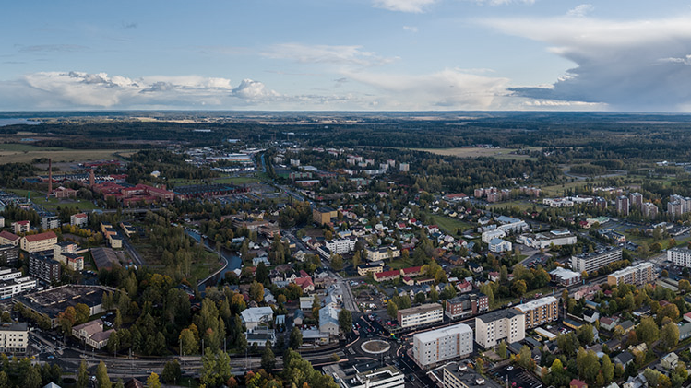
DATA SHARING FROM PILOTS TO BUSINESS PROCESS
AI
AR

Slide 7
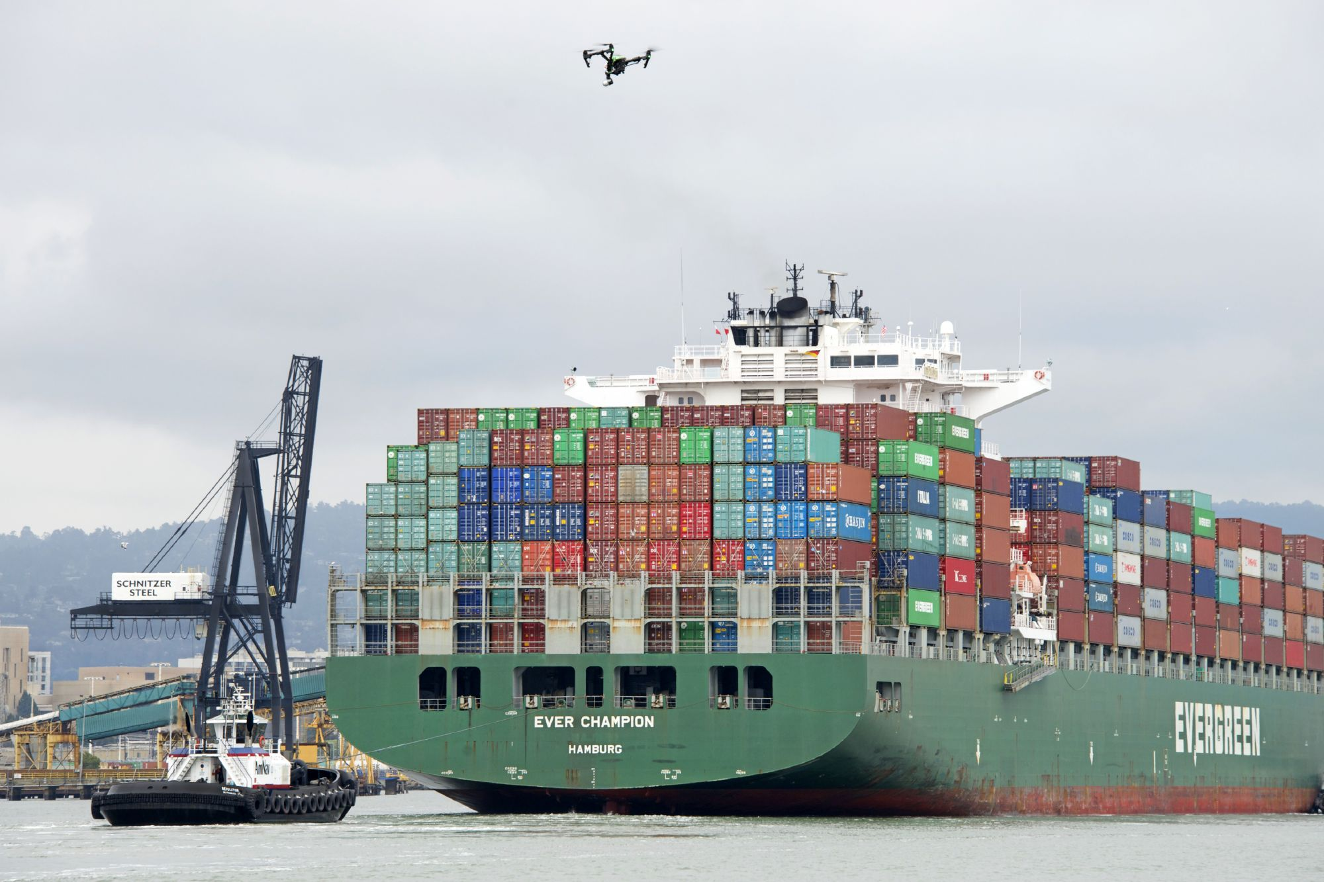
ROBOTICS SUPERVISED BY
AI
BC
MyData

Slide 8

ECOSYSTEMS => BUSINESS ECOSYSTEMS

Slide 9

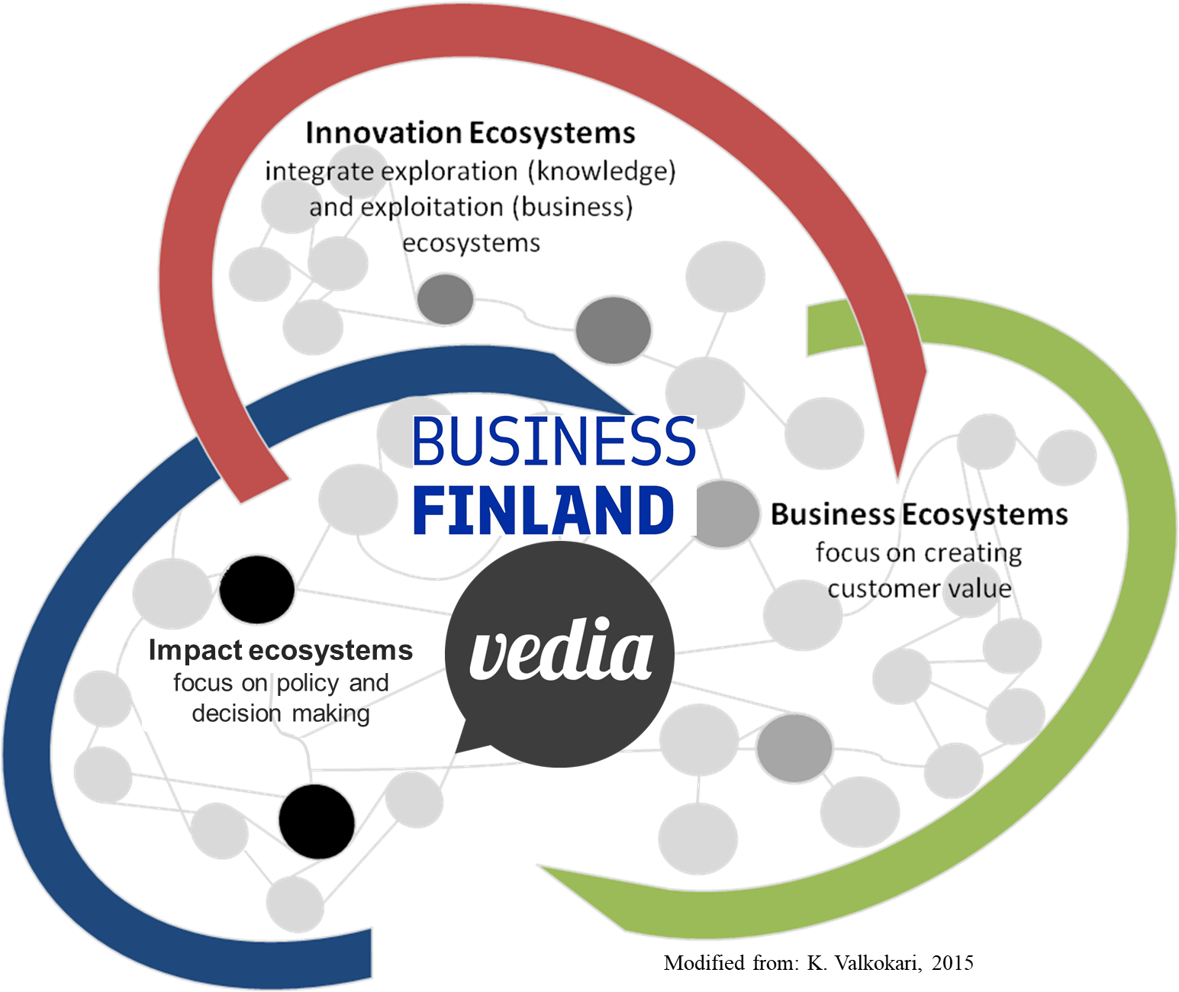
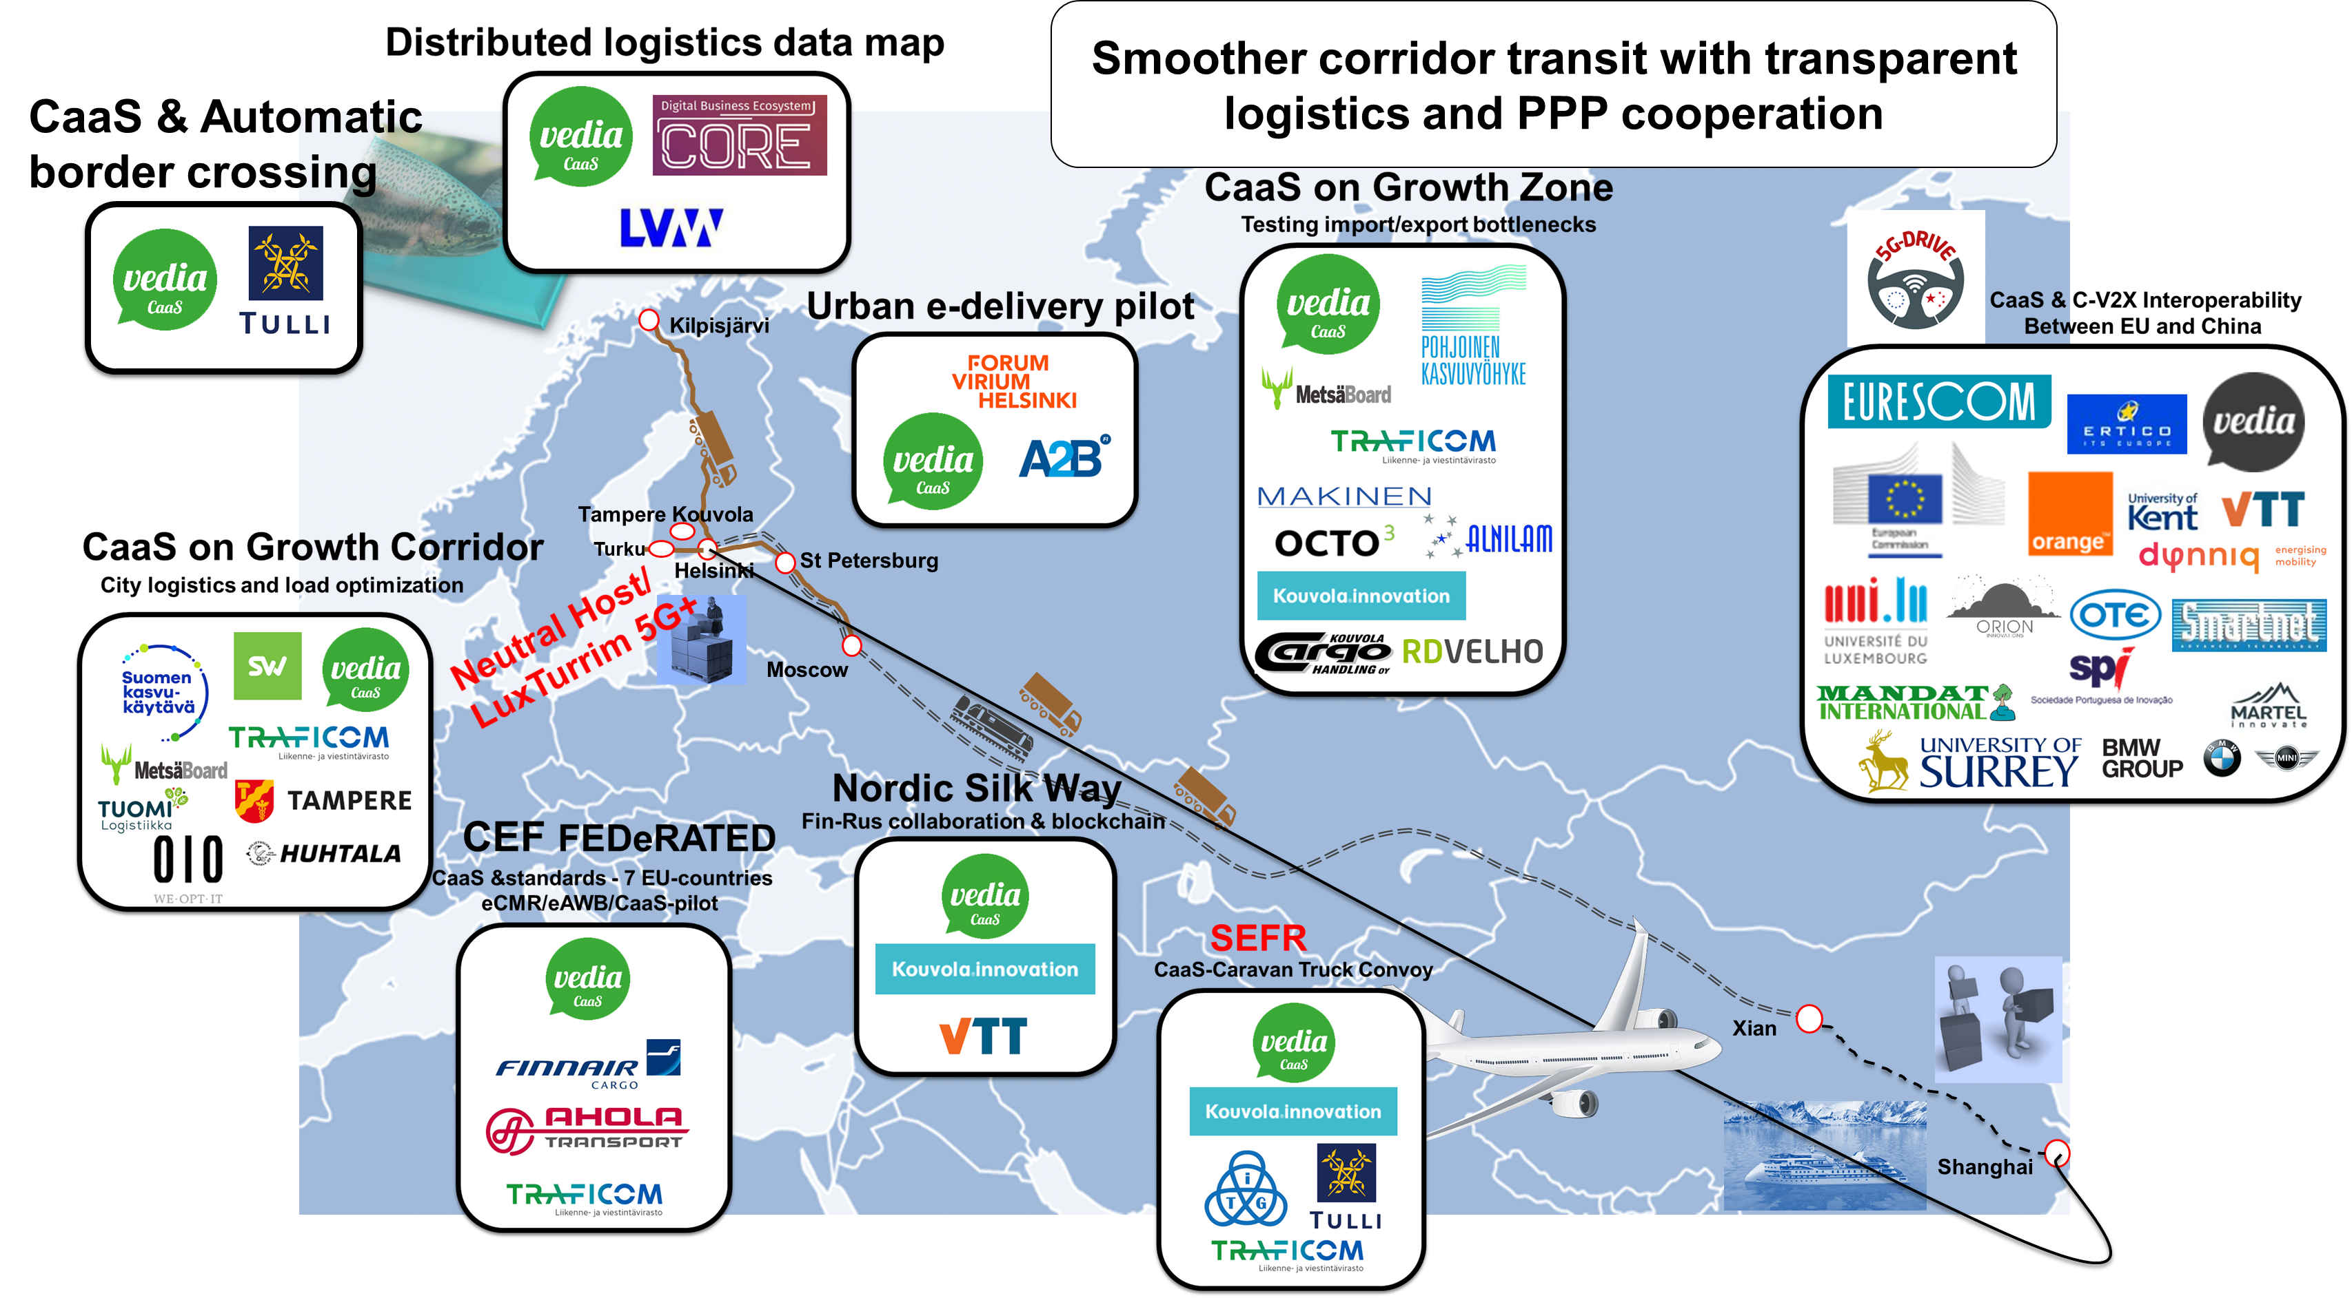
CaaS ecosystem pilots on key corridors

Slide 10

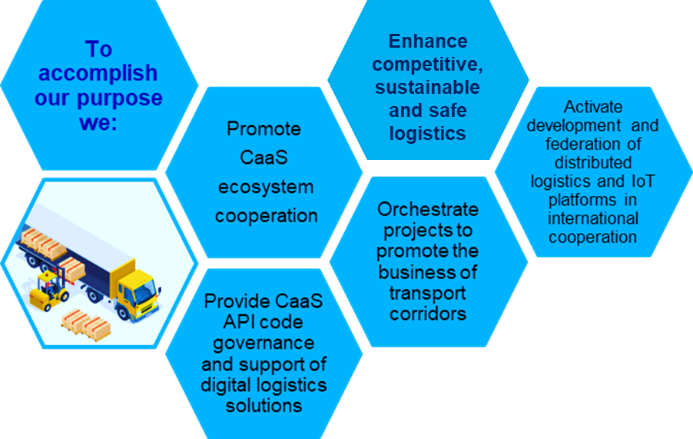
CaaS Nordic association
CaaS Nordic promotes Corridor as a Service expertise, data sharing and living lab activities in regional and international cooperation.
The purpose of the non-profit association is to promote the emergence of an international logistics hub in the Baltic Sea region for freight transport between the East and the West.
www.caasnordic.eu
info@caasnordic.eu
https://www.linkedin.com/groups/8781050/
@CaaSNordic

Slide 11
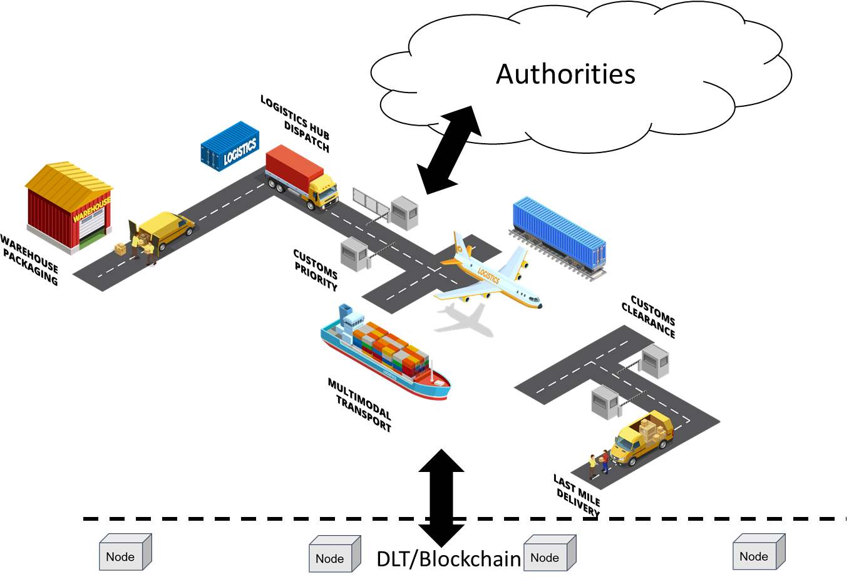
Finnish Business Finland orchestrating proposal
Supply chain visibility
IoT goods tracking
Multimodal transport
APIs
  LSPs
  Authorities
  Cities
  Consignor/consignee
Digital services
  Supply chain - production digital twin
  Booking systems
Data sharing
  DLT
  Blockchain

Slide 12











AVOID BUBBLES IN SUPPLY CHAIN
CaaS Ecosystem
CONCEPTUAL CHANGE MAKES CULTURAL CHANGE

Slide 13




Rethinking transport
27–30 April 2020
#TRA2020
traconference.eu
Organised by:
Co-organised by:

Slide 14
What is TRA?
TRA is THE European Research and Technology Conference when it comes to Transport and Mobility, covering all transport modes and all aspects of mobility
TRA provides an arena for research, industry, public administration and politics to face major challenges and opportunities and to create new European solutions in transport and mobility
TRA gives visibility to both national and international transport research
TRA makes Europe´s achievements in transport research and technology visible on a global scale
TRA participants will have the opportunity to exchange ideas about the conditions and business models for new technological solutions

Slide 15

January 2019
Call for Submissions
opens
3 000+
participants
and visitors
Spring 2019
Call for Demos opens
Private sector
representatives from
multiple industries
100+
journalists from trade, business and news media
Autumn 2019
Final decision on
submissions
TRA
by the
numbers
October 2019
Conference registration
opens
Government,
state and city representatives
Early 2020
Papers and posters
submitted
90+
international
exhibitors
1 000+
abstracts received for TRA2018
27-30 April 2020
TRA2020 HELSINKI
70+
countries

